Slide 1
NLP Exploration
Tim Abramov
Crash Course Edition

Slide 2
Today’s roadmap:
Tokenize
Vectorize
a.k.a Word Embedding
Exercize
a.k.a Train & Fit
Analyze

Slide 3
Tokenize
Regular Expressions
Tokens
how we select/preprocess text
what we select from text

Slide 4
Regular Expressions (regex)
[A-Z]\w+ (select words that start with capital letters)
1 Corinthians 13:4 Charity suffereth long, [and] is kind; charity envieth not; charity vaunteth not itself, is not puffed up,
1 Corinthians 13:5 Doth not behave itself unseemly, seeketh not her own, is not easily provoked, thinketh no evil;
1 Corinthians 13:6 Rejoiceth not in iniquity, but rejoiceth in the truth;
1 Corinthians 13:7 Beareth all things, believeth all things, hopeth all things, endureth all things.
1 Corinthians 13:8 Charity never faileth: but whether [there be] prophecies, they shall fail; whether [there be] tongues, they shall cease; whether [there be] knowledge, it shall vanish away.

Slide 5
Regular Expressions (regex)
\[.*?\] (select anything between square brackets)
1 Corinthians 13:4 Charity suffereth long, [and] is kind; charity envieth not; charity vaunteth not itself, is not puffed up,
1 Corinthians 13:5 Doth not behave itself unseemly, seeketh not her own, is not easily provoked, thinketh no evil;
1 Corinthians 13:6 Rejoiceth not in iniquity, but rejoiceth in the truth;
1 Corinthians 13:7 Beareth all things, believeth all things, hopeth all things, endureth all things.
1 Corinthians 13:8 Charity never faileth: but whether [there be] prophecies, they shall fail; whether [there be] tongues, they shall cease; whether [there be] knowledge, it shall vanish away.

Slide 6
Regular Expressions (regex)
^.*?\d+:\d+ (select “book chapter:verse” at the beginning of the line)
1 Corinthians 13:4 Charity suffereth long, [and] is kind; charity envieth not; charity vaunteth not itself, is not puffed up,
1 Corinthians 13:5 Doth not behave itself unseemly, seeketh not her own, is not easily provoked, thinketh no evil;
1 Corinthians 13:6 Rejoiceth not in iniquity, but rejoiceth in the truth;
1 Corinthians 13:7 Beareth all things, believeth all things, hopeth all things, endureth all things.
1 Corinthians 13:8 Charity never faileth: but whether [there be] prophecies, they shall fail; whether [there be] tongues, they shall cease; whether [there be] knowledge, it shall vanish away.

Slide 7
Tokenizers
NLTK
from nltk.tokenize import word_tokenize
text = "1 Corinthians 13:4 Charity suffereth long, [and] is kind; charity envieth not; charity vaunteth not itself, is not puffed up,"
tokens = word_tokenize(text)
print(tokens)
['1', 'Corinthians', '13:4', 'Charity', 'suffereth', 'long', ',', '[', 'and', ']', 'is', 'kind', ';', 'charity', 'envieth', 'not', ';', 'charity', 'vaunteth', 'not', 'itself', ',', 'is', 'not', 'puffed', 'up', ',']

Slide 8
Vectorize
Bag of Words
Preprocessed book of Genesis (top 20 tokens):
1. (',', 3688), ('and', 2719), ('the', 2443), ('of', 1359),
5. ('[', 1039), (']', 1039), (':', 673), ('his', 653),
9. ('he', 649), ('to', 611), (';', 608), ('in', 594),
13. ('unto', 594), ('that', 520), ('i', 477), ('said', 476),
17. ('him', 348), ('my', 342), ('a', 340), ('was', 317)

Slide 9
Vectorize
TF-IDF
(Term Frequency - Inverse Document Frequency)
Ensures most common words don’t show up as key words
Tokenize Docs
Dictionary
Corpus
Vectors
tokenize each line
token : token id
bag of words on each tokenized line
calculate tf-idf value for each token in doc, in the corpus
['in','the',
'beginning','god',
'created','the',
'heaven','and','the',
'earth','.']
{'.': 0,
'and': 1,
'beginning': 2,
'created': 3,
'earth': 4,
'god': 5,
'heaven': 6,
...}
[(0, 1), (1, 1), (2, 1), (3, 1), (4, 1), (5, 1), (6, 1), (7, 1), (8, 3)]
[(0, 0.0235),(1, 0.0056),
(2, 0.6023),(3, 0.5529),
(4, 0.2904),(5, 0.2132),
(6, 0.4174),(7, 0.1234),
(8, 0.1073)]

Slide 10
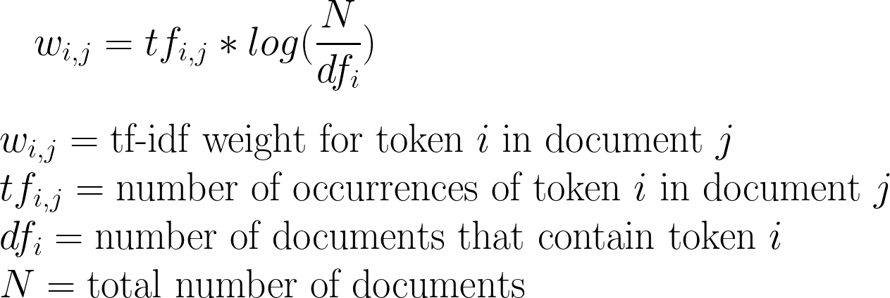
Vectorize
TF-IDF Formula:

Slide 11
Vectorize
Bag of Words Vectors:
1. ('the', 3), ('in', 1), ('beginning', 1), ('god', 1), ('created', 1)
2. ('the', 6), ('and', 4), ('of', 3), ('was', 2), ('upon', 2)
3. ('and', 2), ('there', 2), ('light', 2), ('god', 1), ('said', 1)
4. ('the', 3), ('and', 2), ('god', 2), ('light', 2), ('saw', 1)
5. ('the', 5), ('and', 4), ('called', 2), ('day', 2), ('.', 2)
TF-IDF Vectors:
1. ("beginning", 0.6), ("created", 0.55), ("heaven", 0.42), ("earth", 0.29), ("god", 0.21)
2. ("form", 0.37), ("void", 0.37), ("face", 0.35), ("moved", 0.33), ("darkness", 0.29)
3. ("light", 0.82), ("there", 0.42), ("let", 0.24), ("god", 0.16), ("be", 0.16)
4. ("light", 0.7), ("darkness", 0.38), ("divided", 0.34), ("god", 0.27), ("good", 0.24)
5. ("day", 0.41), ("darkness", 0.38), ("called", 0.37), ("light", 0.35), ("evening", 0.33)

Slide 12
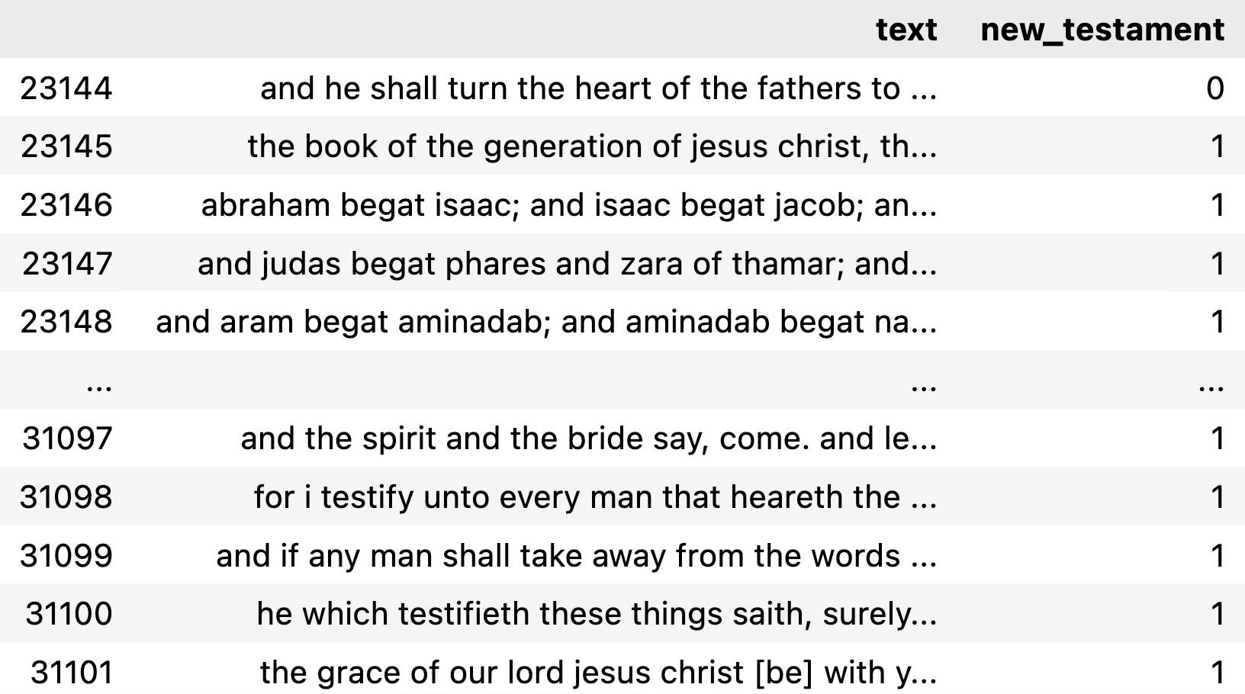
Supervised Learning
Dataset
N of verses:

Slide 13
Supervised Learning
Dataset Split
#split by train and test data
X_train, X_test, y_train, y_test = train_test_split(
verses_data["text"], verses_data["new_testament"],
test_size=0.33, random_state=69420
)

Slide 14
Supervised Learning
Vectorizers:
CountVectorizer
TfidfVectorizer
count_vectorizer = CountVectorizer(stop_words="english")
count_train = count_vectorizer.fit_transform(X_train)
count_test = count_vectorizer.transform(X_test)
count_train.shape
tfidf_vectorizer = TfidfVectorizer(stop_words="english", max_df=0.7)
tfidf_train = tfidf_vectorizer.fit_transform(X_train)
tfidf_test = tfidf_vectorizer.transform(X_test)
tfidf_train.shape
(20838, 10723)
(20838, 10723)
num of training vectors
vector size/dim

Slide 15
Supervised Learning
Model: Naive Bayes(MultinomialNB) from sklearn
CountVectorizer
TfidfVectorizer
Accuracy: 0.9217
 | Pred Neg | Pred Pos | Total
Act Neg | 7277(0.71) | 324 (0.03) | 7601 (0.74)
Act Pos | 479 (0.05) | 2184(0.21) | 2663 (0.26)
Total | 7756(0.76) | 2508(0.24) | 10264(1.00)
Accuracy: 0.8900
 | Pred Neg | Pred Pos | Total
Act Neg | 7572(0.74) | 29 (0.00) | 7601 (0.74)
Act Pos | 1100(0.11) | 1563(0.15) | 2663 (0.26)
Total | 8672(0.84) | 1592(0.16) | 10264(1)

